Slide 1
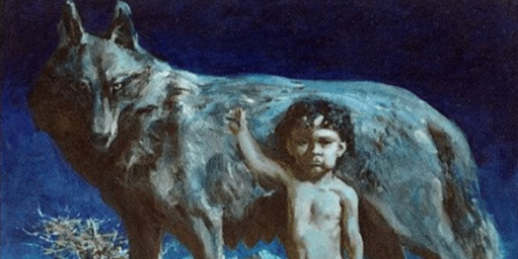
- BorTecıne Run -

Slide 2
THE Mythologıcal HISTORY of the game
In an era of brutal Mongol and Chinese attacks on the ancestor Turkish people, a female wolf finds a baby alone in the mountains. The motherly instincts of the female wolf takes over, she saves his life and begins to raise him. This baby will become Oğuz Kağan, one of the greatest hero & leader in Turkish mythology.
The wolf wants to protect the baby from witnessing further bloodbaths, so she sets off to bring him to a peaceful place. Sensing the child’s great life mission, she also plans to train him for leadership and warrior skills at that place.
During the long journey to get there, while the wolf mother carries the baby on the back, they enter the Iron Mountains, full of obstacles. With no water and a very long path ahead, the wolf must run fast. If they crash into any obstacles, they will die, and the future hero will never be. Turkey’s fate depends on this journey.

Slide 3
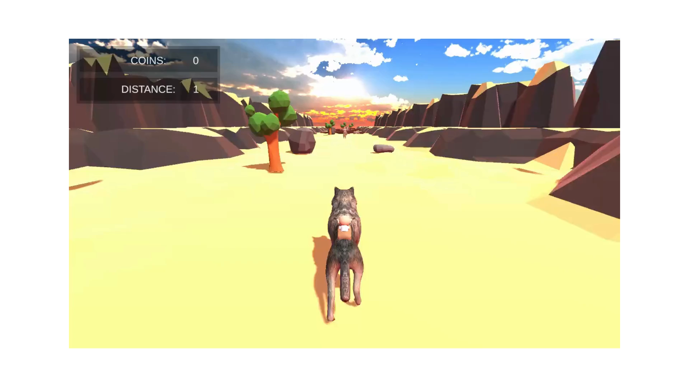
Trailer

Slide 4
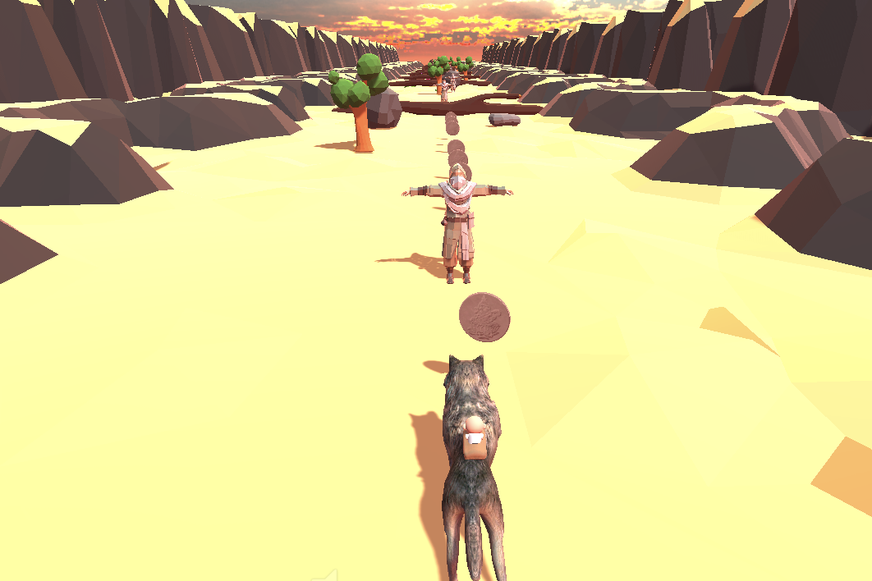
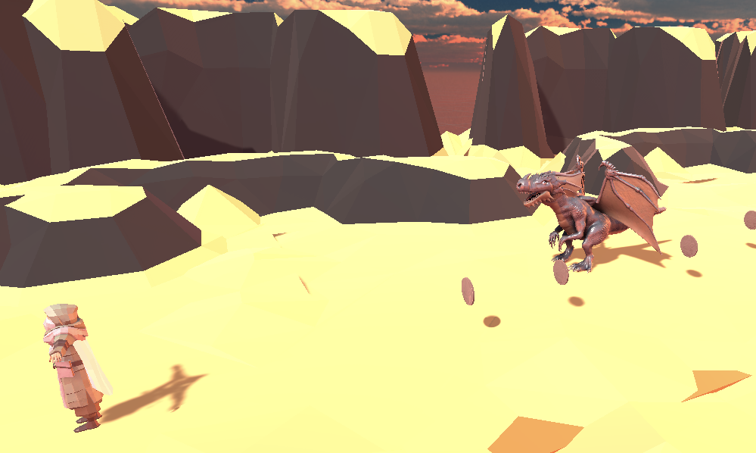
Game Objectıves
The player takes on the role of the wolf mother.
Goal:
Surviving as long as possible through avoiding obstacles: The player runs on a with the baby on the back, avoiding obstacles along the road to survive.
Collecting as many coins as possible: There are gold coins scattered along the path. Collecting as many coins as possible will give the baby the wealth needed to live a life among humans when he reaches his leadership age.
Elements:
1 Live
Gold Coins Collections

Slide 5
Core MECHANICS
Endless Run – Real-Time Generated Map & Obstacles
Running on a straight road. The roads x axis amount is within a given boundary range (Closed System)
Avoiding Obstacles through directioning the wolf with WAD keys /or up-left-right keys arrow keys for jumping, moving left and right, respectively. The space key can also be used for jumping.
Collecting Coins as many as possible during the run

Slide 6
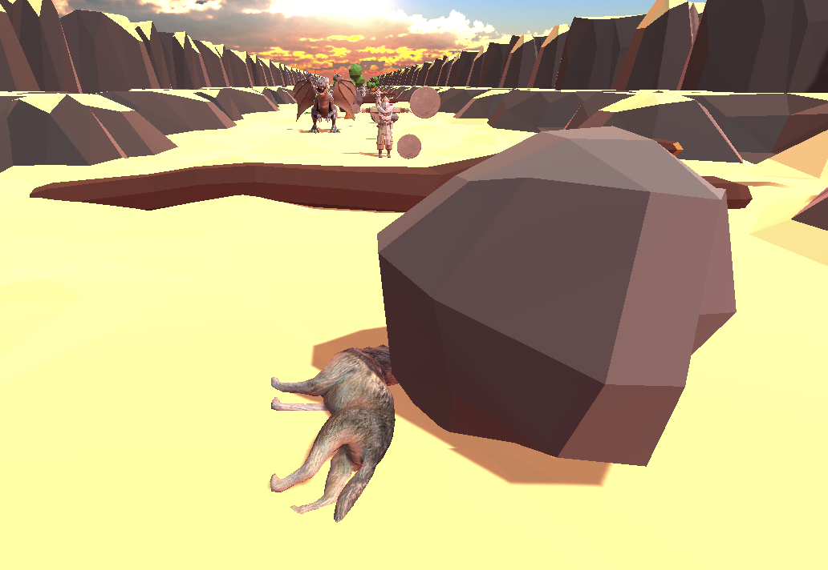
Game DYNAMICS
Interaction Type:
Player vs. Game
Challenge & Game Flow:
Rising Difficulty to Stay Alive over Time:
The player begins the game with a slow speed rate, but over time, the running
speed increases, which puts the player under stress, hence making it more
difficult to achieve great performance/ to stay alive (not colliding with obstacles).
Feedback:
Feedback on how much coins collected and the distance run so far.

Slide 7
Player & Game Type
According to Bartle’s 4 Player types, the Player is of type Achiever
Infinity-Long Game
Cooperative (need to play within giving rules or else will die),
Non-Zero Sum (not winning at the cost of the loss of an opponent, there is no opponent)
Dynamic Game: The game evolves over time, with decisions made at different stages that affect future outcomes.
Sequential game (where player makes decisions one after another, affecting the future state; the wolf makes decisions based on the current state of the journey, such as whether to run, stop, or avoid obstacles. Each action influences the current game state and the wolf must continuously adapt to the changing environment. The wolf's actions affect both the immediate survival and the eventual leadership of the baby.
Imperfect Game, because the map is generated in real-time, hence the woplf does not know which obstacles are where on the road, until being there

